Slide 1
Front End Engineering-I Project
Team Details:
Krish Garg 2410992948
Hitesh Gautam 2410992928
Kanika 2410992932
Faculty Coordinator:
Mr Rahul Rajeevan
:
Chitkara University Institute of Engineering and Technology,
Chitkara University, Punjab

Slide 2
Table of Contents
Introduction
Problem Statement
Technical Details
Key Features
Project Highlights
Conclusion
References/Links used

Slide 3
Introduction
Text Track is an innovative test management platform that empowers users to create, administer, and manage access to multiple tests efficiently. Designed for educational institutions, corporate training programs, and online learning environments, Text Track simplifies the entire process of test administration, from building tests to delivering results and analytics.

Slide 4
Problem Statement
In today’s educational and corporate environments, the process of creating, administering, and managing multiple tests can be complex, time-consuming, and prone to human error. Traditional methods of test administration often lack scalability, real-time monitoring, and centralized management, resulting in inefficiencies for educators, trainers, and administrators.

Slide 5
Technical Details
HTML
HTML (Hyper Text Markup Language) is the standard language used to create and structure
content on the web. HTML defines the structure and layout of a web page by using a series of
elements or tags that wrap different parts of the content to display text, images, links, tables,
forms, and multimedia on web browsers.
CSS
CSS (Cascading Style Sheets) is a stylesheet language used to describe the presentation (look
and formatting) of a document written in HTML. CSS controls the layout, colors , fonts,
spacing, and overall appearance of web pages, allowing developers to style content
independently of HTML structure.

Slide 6
JAVA SCRIPT
JavaScript is a versatile, high-level programming language primarily used to make web
pages interactive. It runs in the browser, allowing developers to add features like animations,
form validation, dynamic updates, and interactive content to websites.
ANIMATION
Animation is the process of creating the illusion of movement by displaying a sequence of
images or frames that change slightly over time. It’s widely used in fields like film, gaming,
web design, and advertising to engage viewers and convey dynamic stories, emotions, or
interactions.
BOOTSTRAP
Bootstrap was used in the Test Track project to create a responsive and user-friendly
interface, ensuring seamless performance across various devices. Its pre-built components
and grid system enabled quick development of consistent UI elements, such as navigation
bars and buttons. Additionally, Bootstrap’s customizable framework allowed for easy
adaptation of the design to fit the project’s specific requirements

Slide 7
Key Features
1.Test Creation And Management:
Users can design and customize multiple types of tests, including quizzes, exams, and assessments, with various question formats like multiple-choice, true/false, and essay.
Flexible tools allow the setup of time limits, difficulty levels, and custom scoring.
2.Centralized Question Bank:
Text Track offers a comprehensive question bank that allows users to store, categorize, and reuse questions across multiple tests.
Search, filter, and tag questions by topic, subject, or complexity, providing an easy way to organize large question repositories.
3. Automated Grading and Instant Feedback:
Objective tests are automatically graded, delivering instant feedback and results to participants.Detailed analytics and reports help track performance trends, enabling deeper insights into student or employee progress.
4. Access Control and Test Scheduling:
Easily manage access to tests with role-based permissions and test scheduling features.Grant selective access to specific users, whether students, instructors, or administrators.
5. Real-Time Monitoring and Security:
Generate detailed performance reports for individuals or groups, identifying strengths and areas for improvement.Export reports for analysis or share them with stakeholders, ensuring transparency in test results.

Slide 8

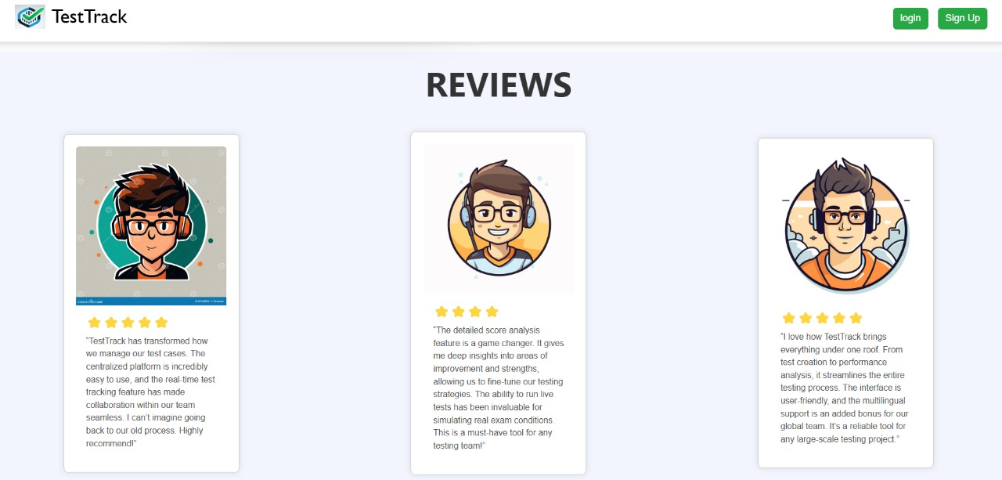
Project Highlights

Slide 9
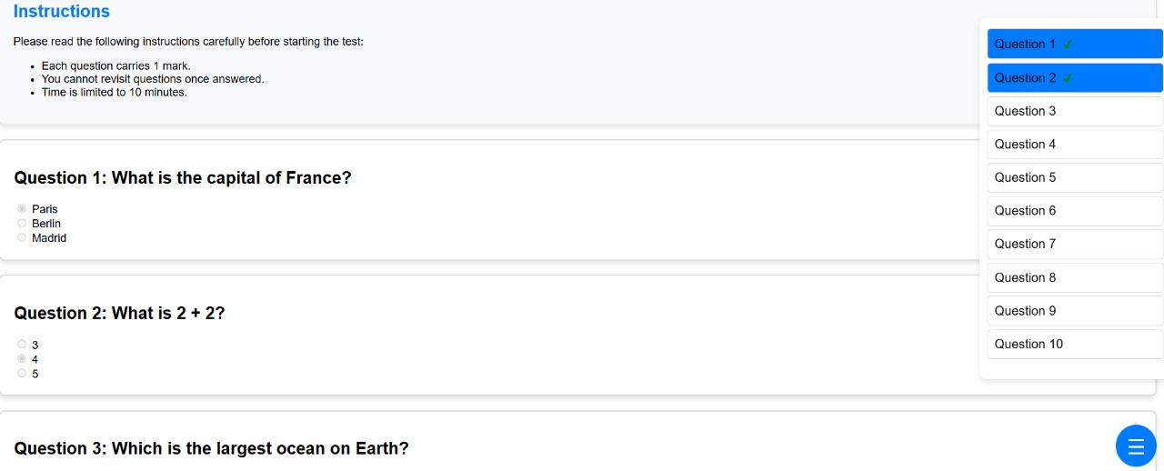
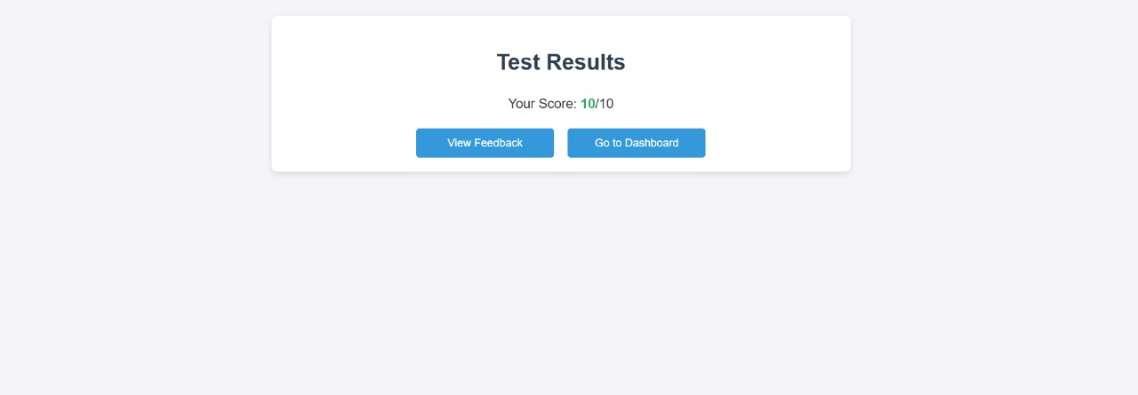
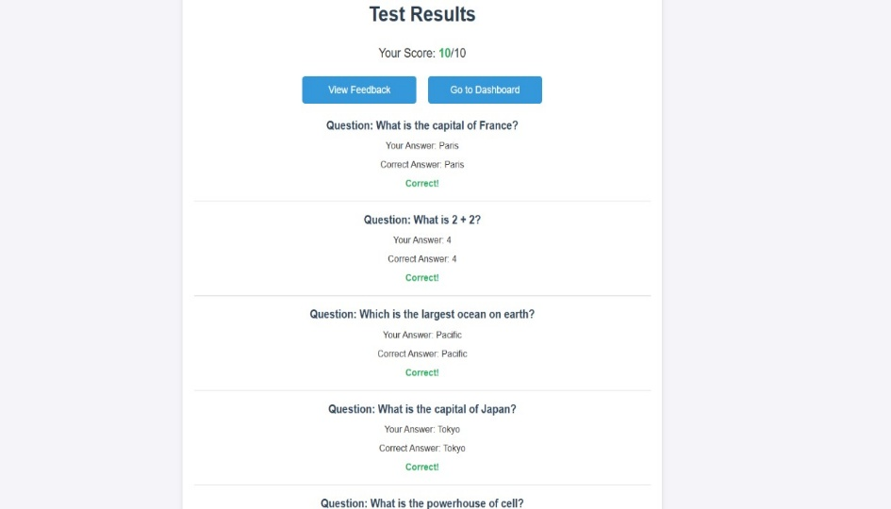

Slide 10
Conclusion
The Test Track website successfully addresses the challenges associated with traditional assessment methods by offering a streamlined, automated, and user-friendly platform for creating, administering, and grading online tests. With features like real-time progress tracking, instant feedback, and an analytics dashboard, it enhances the testing experience for both administrators and test-takers. By utilizing responsive design and powerful front-end technologies like Bootstrap, the platform ensures accessibility across devices, providing a consistent experience. Moving forward, the system's potential for integration with other platforms, AI-powered features, and mobileapplications makes Test Track a scalable solution for modern educational and corporate environments

Slide 11
References
References used by us to solve the problems while creating the fitness tracker:
8.1 MDN Docs : https://developer.mozilla.org/en-US/
8.2 W3 Schools : https://www.w3schools.com/
8.3 TestBook : https://testbook.com/
8.4 Google Fonts : https://fonts.google.com/
8.5 Chatgpt : https://chatgpt.com/
8.6 Pexels : https://www.pexels.com/
8.7 CSS Scan : https://getcssscan.com/css-box-shadow-example

Slide 12


